Slide 1
INTERNSHIP PRESENTATION
NAME : CHETAN B USN : 4AL21IS402 BRANCH : ISE

Slide 2
VTU SKILL ENHANCEMENT COURSE
Job-Ready Pro: Python, React, MS Office, Data Structures & Interview Mastery

Slide 3
STATUS OF COURSE
1 Course completed out of 5 Courses .
20 % course has been completed .

Slide 4
COMPLETED COURSE MATERIAL - REACT JS
REACT FULL STACK - For Building dynamic web applications
Module 1 and 2 - Basic HTML > HTML provides the structure of a webpage. , HTML forms > Forms are used to collect user input. , HTML images > Images enhance UI. <form> <input type="text" placeholder="Enter Name"> <button type="submit">Submit</button> </form>
Module 3 - CSS > CSS styles the webpage for better presentation. button { background-color: blue; color: white; padding: 10px; }

Slide 5
Module 4 - Bootstrap > A CSS framework for responsive design. <button class="btn btn-primary">Click Me</button>
Module 5 - React Installations Install Node.js, then: npx create-react-app my-app cd my-app npm start

Slide 6
Module 6 - Basics of React – JSX > Combines HTML and JavaScript. , Hooks > Manage state and lifecycle. , array > , table > . Jsx code: const [count, setCount] = useState(0); <button onClick={() => setCount(count + 1)}>Increase</button>
Module 7 - React cards > Used to display structured content. <Card> <Card.Body> <Card.Title>Title</Card.Title> <Card.Text>Description</Card.Text> </Card.Body> </Card>

Slide 7
Module 8 - React use effect > Runs effects in function components. useEffect(() => { console.log("Component Mounted"); }, []);
Module 9 - Api , Fetch Api useEffect , Fetch Api delete . - Fetching and deleting data. fetch("https://api.example.com/data") .then(res => res.json()) .then(data => console.log(data));

Slide 8
Module 10 & 11 - Dynamic Search > Filters data dynamically. const [search, setSearch] = useState(‘’); const filteredData = data.filter(item => item.name.includes(search));
Module 12 & 13 - useForms > Handle form inputs. and React routers > Manage navigation. <Routes> <Route path="/home" element={<Home />} /> </Routes>

Slide 9
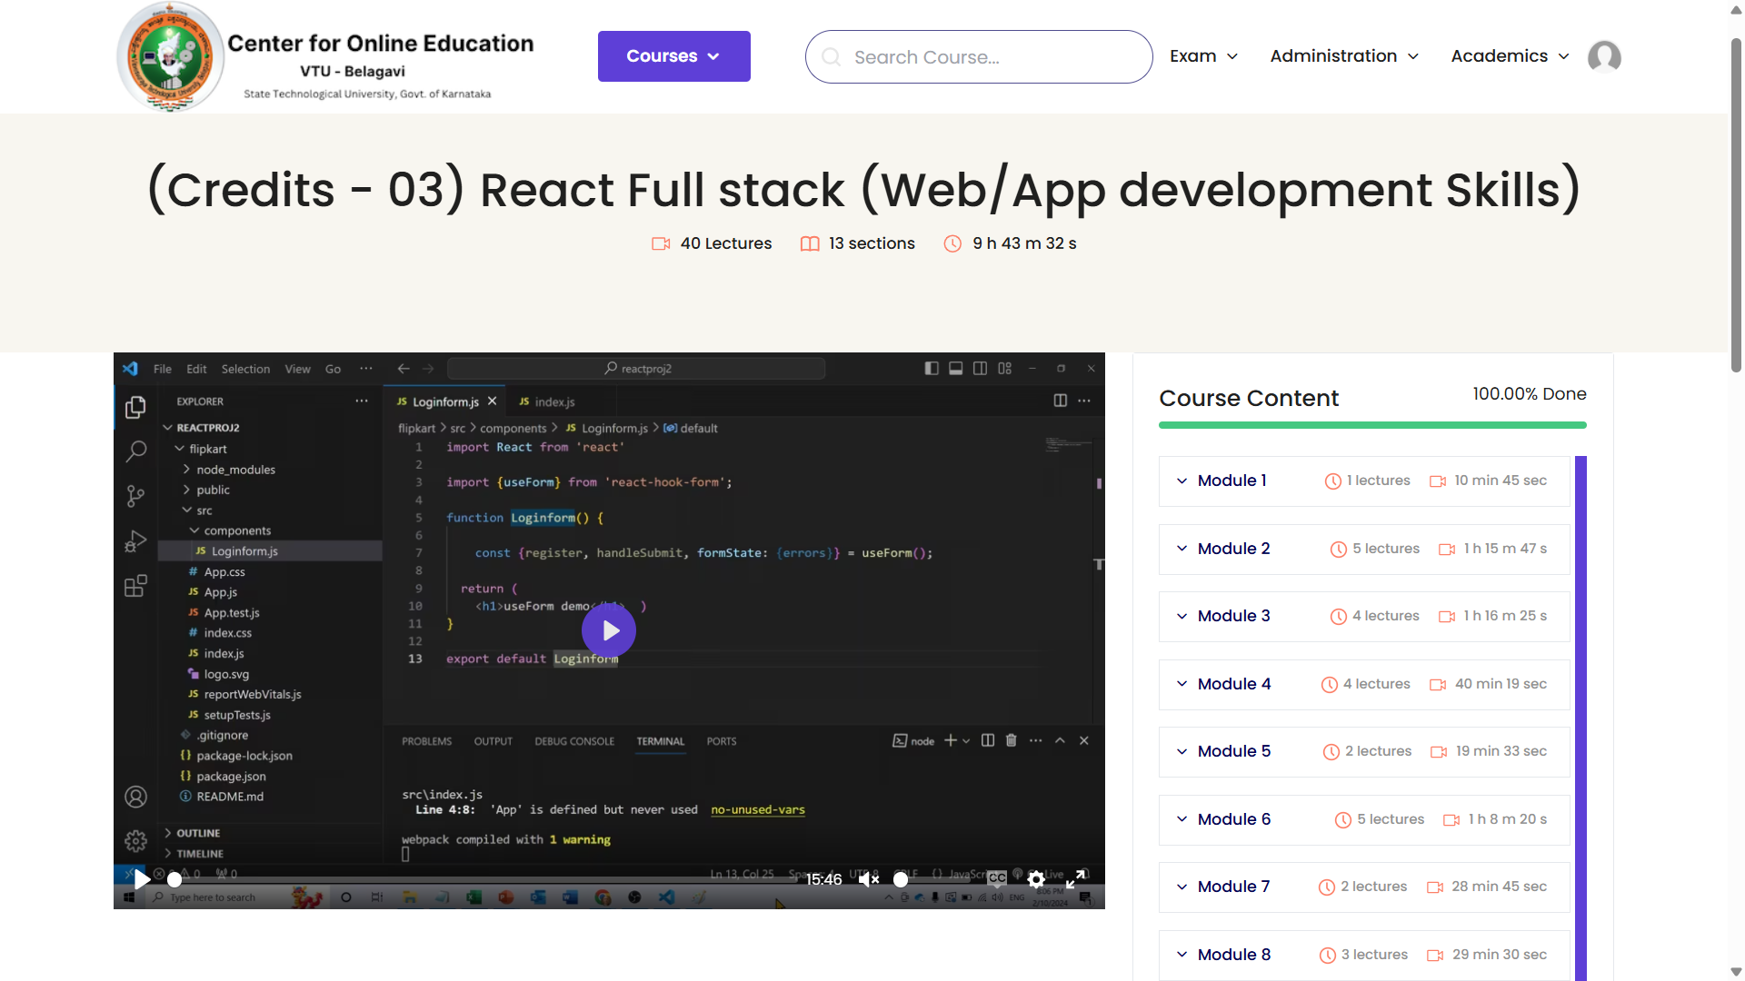

Slide 10
THANK YOU

